Slide 1
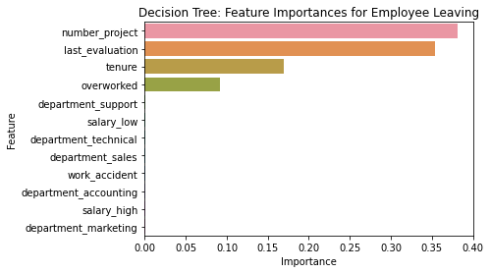
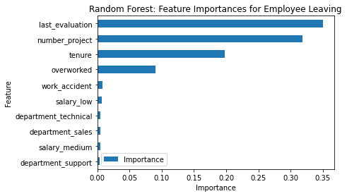
Salifort Motors
Employee Retention Project
Salifort Motors seeks to improve employee retention and answer the following question:
What’s likely to make the employee leave the company?
Since the variable we are seeking to predict is categorical, the team could build either a logistic regression or a tree-based machine learning model.
The random forest model slightly outperforms the decision tree model.
Barplot above shows the most relevant variables: ‘last_evaluation’, ‘number_project’, ‘tenure’ and ‘overworked’.
This model helps predict whether an employee will leave and identify which factors are most influential. These insights can help HR make decisions to improve employee retention.
In the random forest model above, `last_evaluation`, `tenure`, `number_project`, `overworked`, `salary_low`, and `work_accident` have the highest importance. These variables are most helpful in predicting the outcome variable, `left`.
Cap the number of projects that employees can work on.
Consider promoting employees who have been with the company for at least four years, or conduct further investigation about why four-year tenured employees are so dissatisfied.
Either reward employees for working longer hours, or don't require them to do so.
If employees aren't familiar with the company's overtime pay policies, inform them about this. If the expectations around workload and time off aren't explicit, make them clear.
Hold company-wide and within-team discussions to understand and address the company work culture, across the board and in specific contexts.
High evaluation scores should not be reserved for employees who work 200+ hours per month. Consider a proportionate scale for rewarding employees who contribute more/put in more effort.

Slide 2
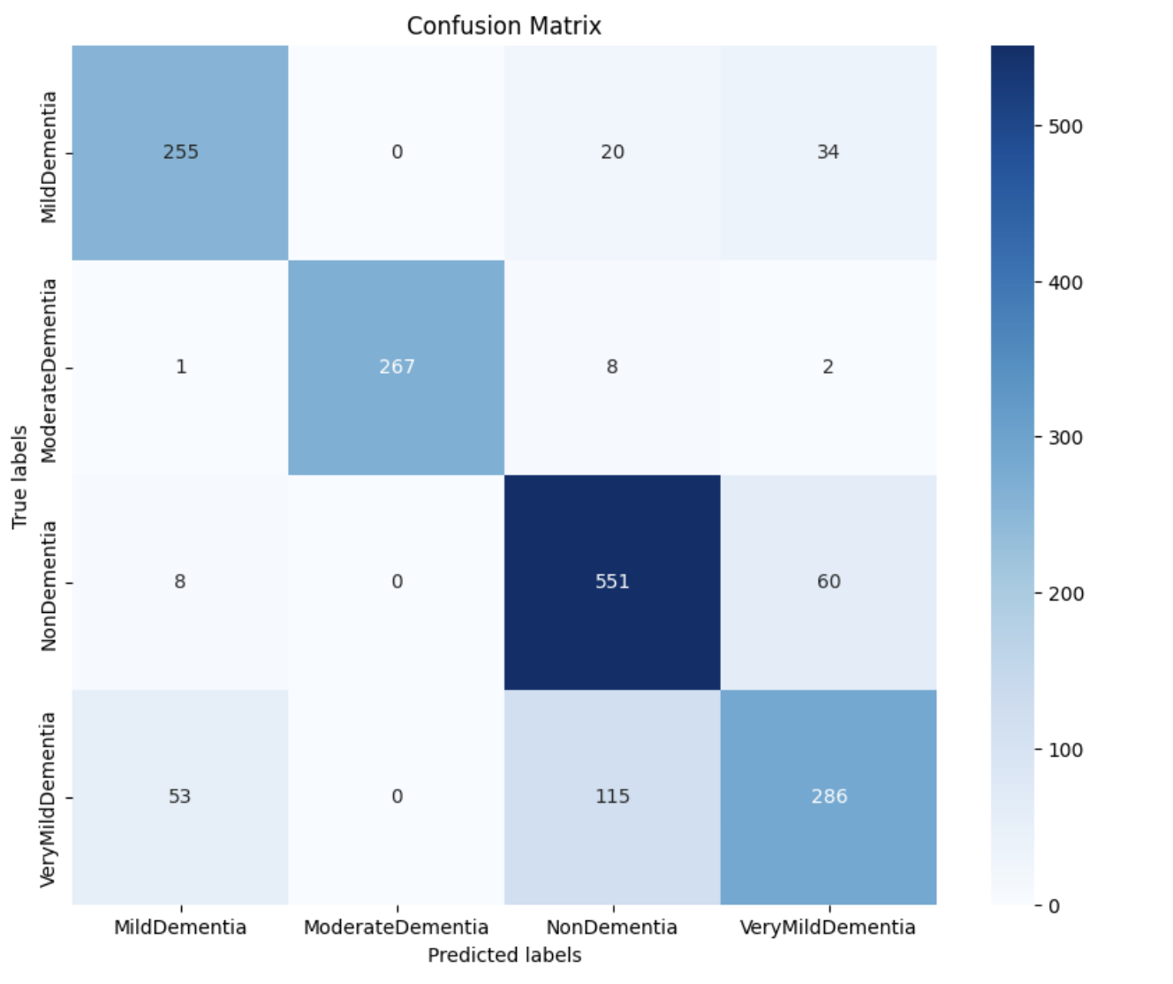
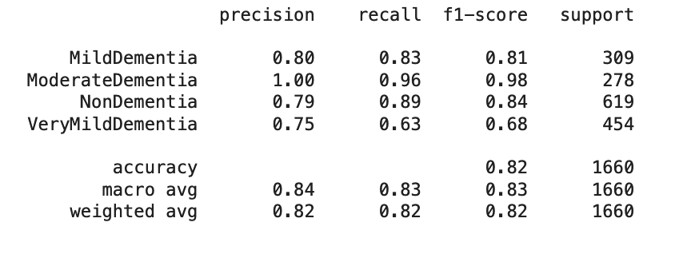
Integrative Approach to Disease Detection and Classification through Image Analysis: Alzheimer's Dementia and Brain Tumour
Issue:
Developing precise Alzheimer's classification with MRI data is tough. The link between brain tumors and Alzheimer's needs exploration. Current classification methods lack strength, requiring better frameworks.
Response:
New ML techniques promise significant advancements in Alzheimer's understanding and diagnosis, crucial for better patient care. Hence, we will be predicting results by using Neural network models like SVM, ResNet.
Impact:
This helps spot and classify brain disorders earlier. Finding problems sooner means treatments can start quicker and be more tailored. It's a big step in improving how well patients do and their overall quality of life.
The CNN model achieved an accuracy of approximately 82% accuracy.
The macro average treats all classes as equally important, resulting in a balanced average of the precision and recall across all classes, which is around 0.83 and 0.83 respectively.
From the confusion matrix the model is performing decently on the validation data. The AUC is a metric to be considered as the classes are imbalanced. The AUC indicates how well our model is able to distinguish between different classes, which in our case it is doing really well.
Insights/Next Steps:
Investigate the reproducibility of back-to-back scans at different intervals.
Examine the impact of the MRI scanner on the data, identifying variations or trends.
Deploy the model on Flask

Slide 3
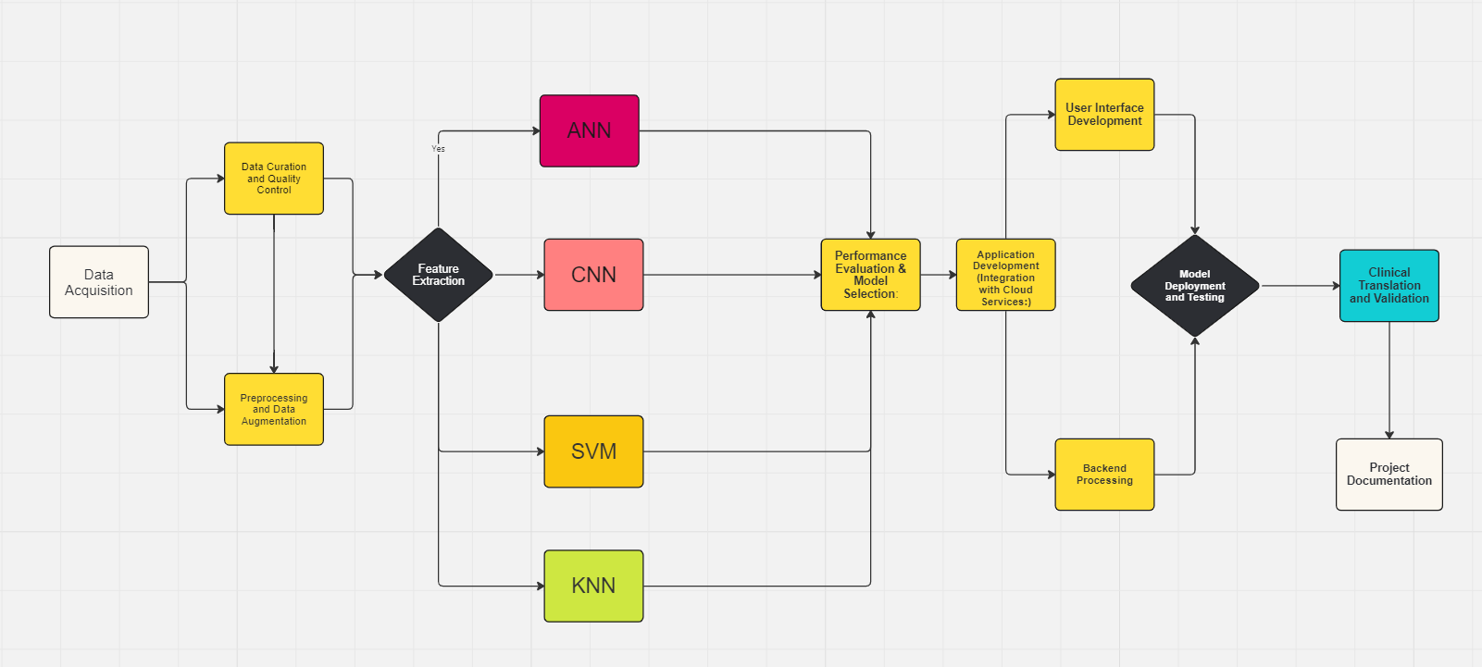
Project Architecture
The selection of algorithms is guided by their suitability for handling medical image data, scalability, and performance in disease detection and classification tasks. Each algorithm contributes to the development of predictive models aimed at improving diagnostic accuracy and therapeutic strategies for neurodegenerative disorders
Programming Languages: Python (Pandas, NumPy, Scikit-learn, TensorFlow, Keras)
Machine Learning Algorithms: CNNs, SVMs, KNN, ANNs
Data Processing: MRI image preprocessing, feature extraction, data augmentation
Evaluation Metrics: Accuracy, Precision, Recall, F1-score, AUC
Tools: Jupyter Notebooks, Git, SQL, PowerBI

Slide 4
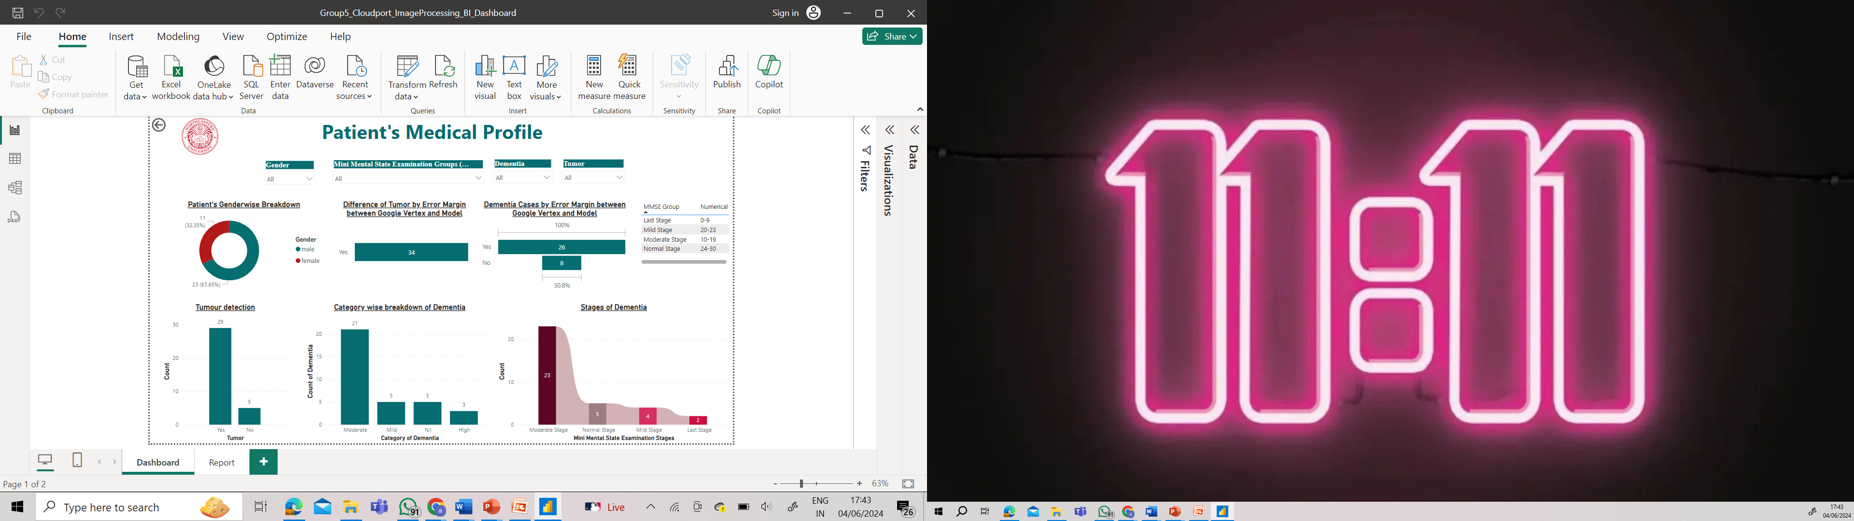
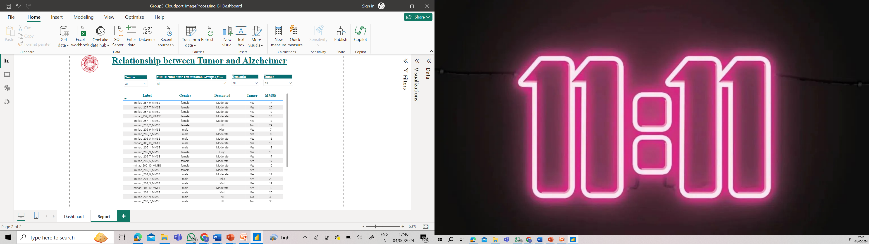
Created an interactive dashboard which shows us patient's medical profile based on MRI and Dementia levels and is in sync with the report

Slide 5
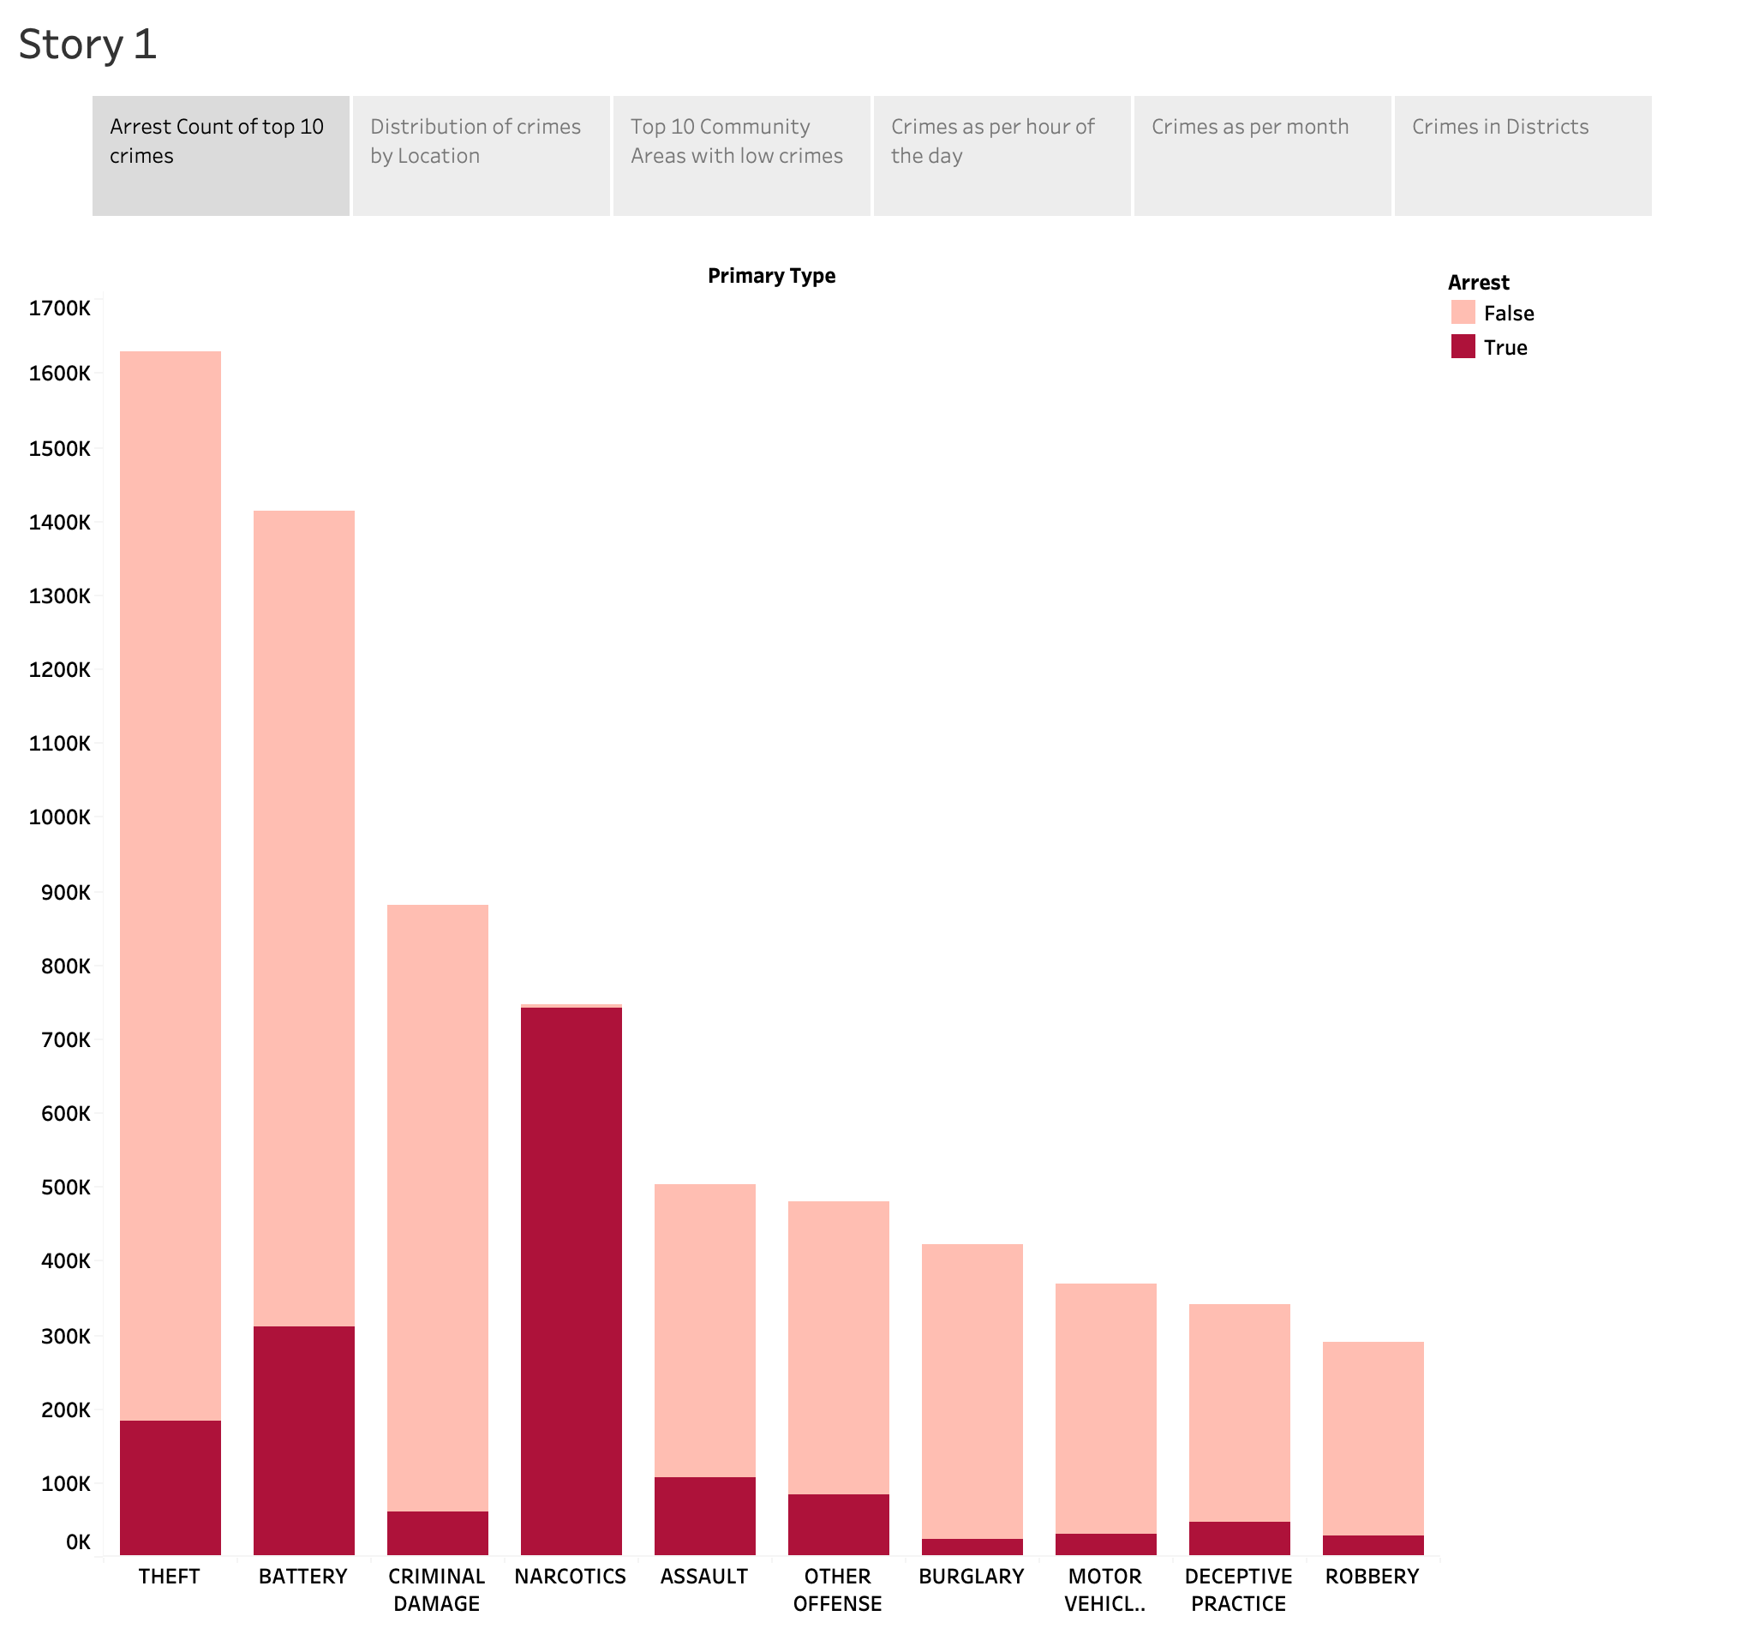
Visualization of Chicago crimes Investigation
Issue:
This project entails analyzing and visualizing crime data in Chicago using Tableau to uncover insights into crime trends, patterns, and distributions. The study aims to inform public safety initiatives and crime prevention strategies by providing a detailed understanding of crime dynamics across various dimensions such as time, location, and crime type.
Response:
Crime trend analysis
Public safety improvement
Crime hotspot identification
Criminal activity pattern recognition
Fraud detection and prevention
Impact:
The project enhances the understanding of crime dynamics in Chicago, providing valuable insights that can be leveraged by law enforcement agencies and policymakers to devise effective crime prevention strategies. The visualizations and dashboards developed serve as powerful tools for ongoing monitoring and analysis, facilitating a data-driven approach to public safety.
We can see here Top 10 crimes who have been arrested and not arrested .
Theft being the topmost crime.
Narcotics is the only crime where all arrests were made.
Most of the criminals are not arrested in theft cases.

Slide 6
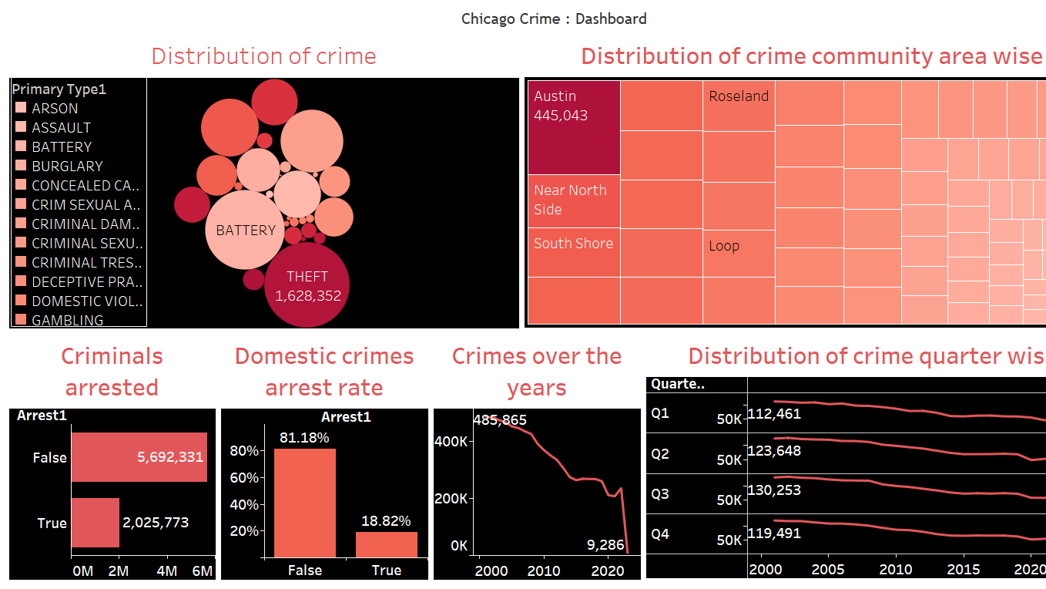
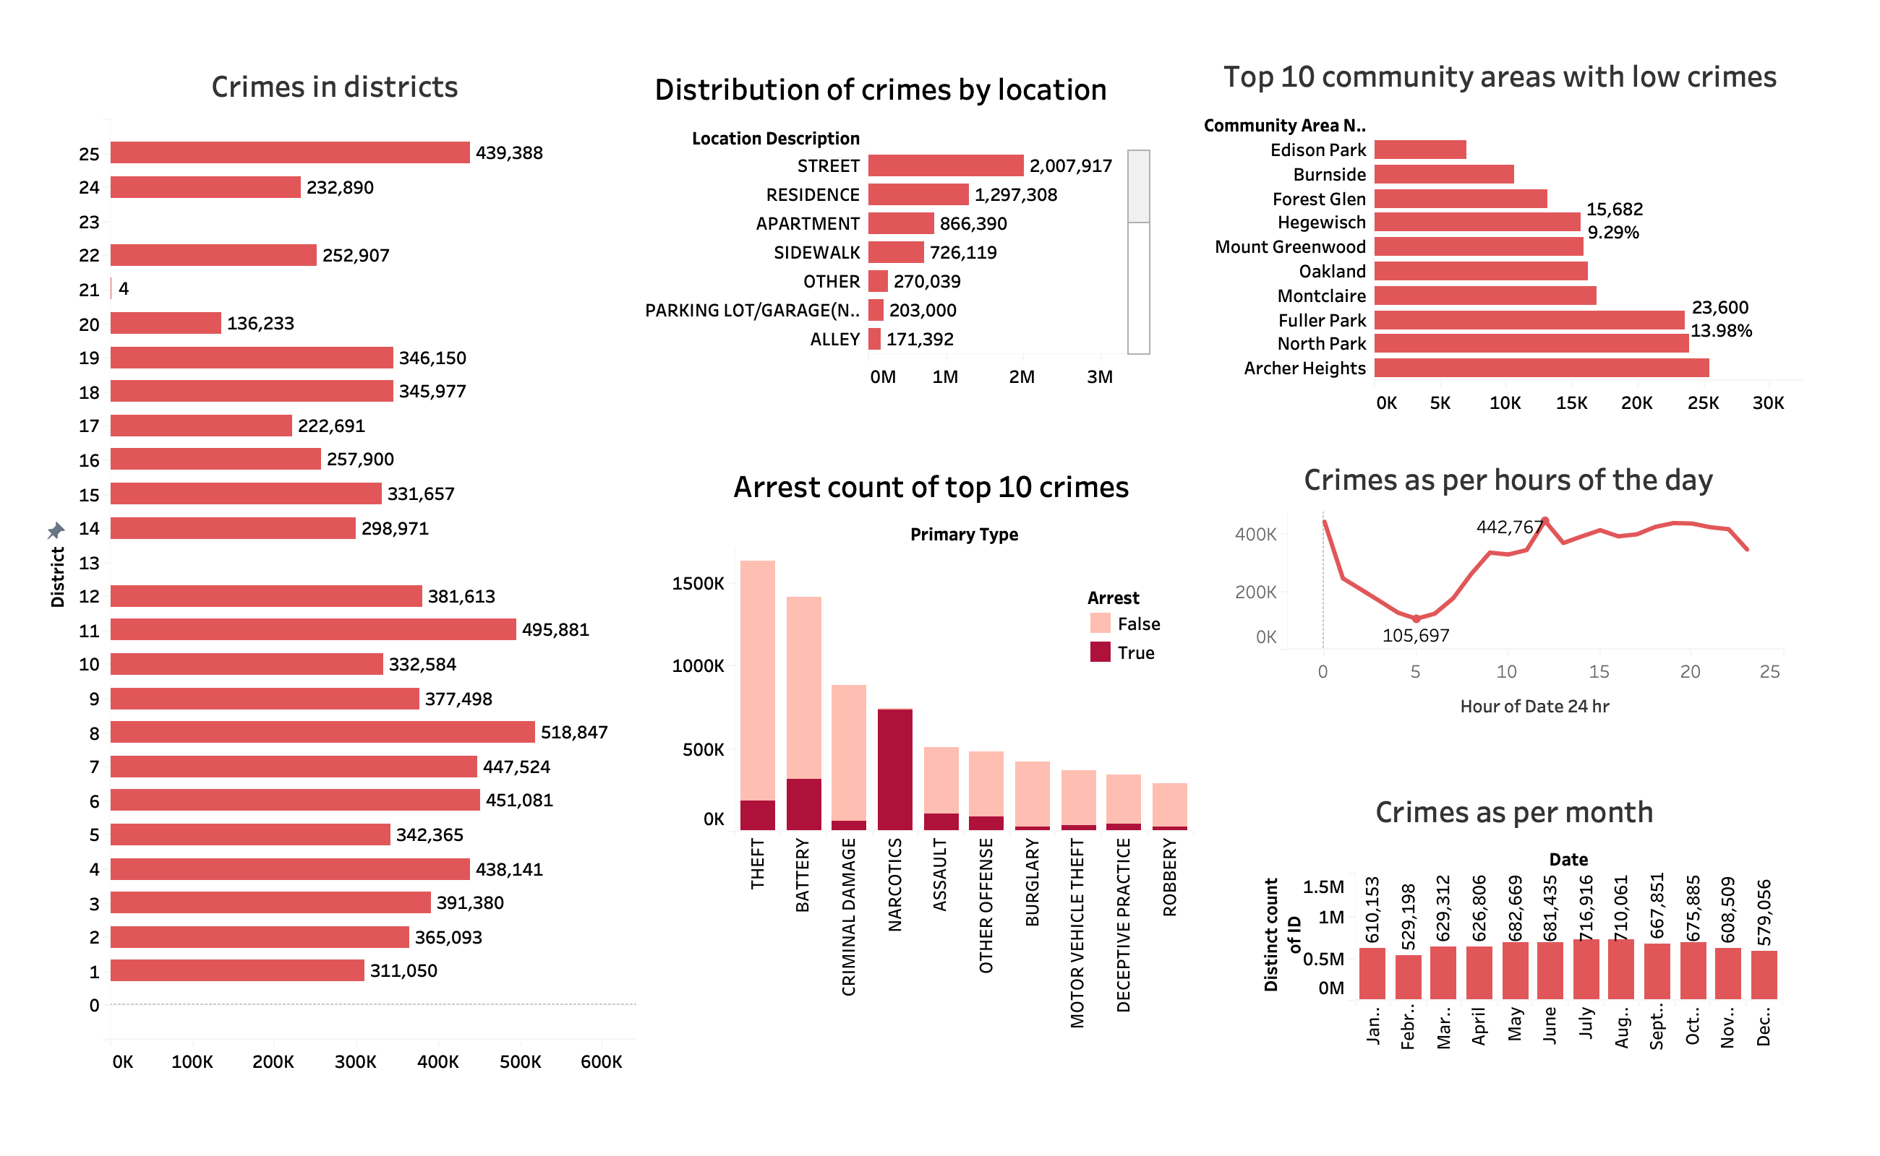

Slide 7
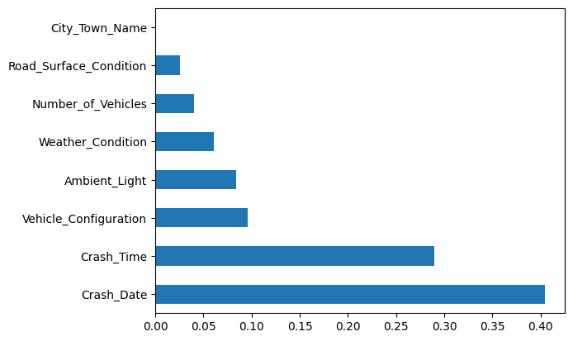
Massachusetts Motor Vehicle Crash Data Analysis
Issue:
This project analyzes Massachusetts motor vehicle crash data from 2002 to 2022 to identify trends, patterns, and areas for improving road safety using Python and various data analysis techniques.
Response:
Linear regression model performed well with a perfect score of 1.0 in predicting the number of vehicles involved in crashes.
Logistic regression model showed room for improvement with an accuracy score of 0.626.
Applying L2 regularization did not significantly enhance the logistic regression model's performance.
Impact:
Our findings suggest that machine learning models can be effective tools for predicting the likelihood of a crash involving multiple vehicles and can be useful in improving road safety.
We recommend using the CatBoost or XGBoost model for predicting whether a crash involves 2 or more vehicles due to their high accuracy and AUC scores.
Decision Tree:
The bar chart shows feature importance scores for the variables Crash_Date and City_Town_name in the Decision Tree model.
Crash_Date has a high importance score of approximately 0.40, indicating its significant impact on the model's predictions.
City_Town_name has a low importance score close to 0.0, suggesting minimal influence on the model's predictions.

Slide 8
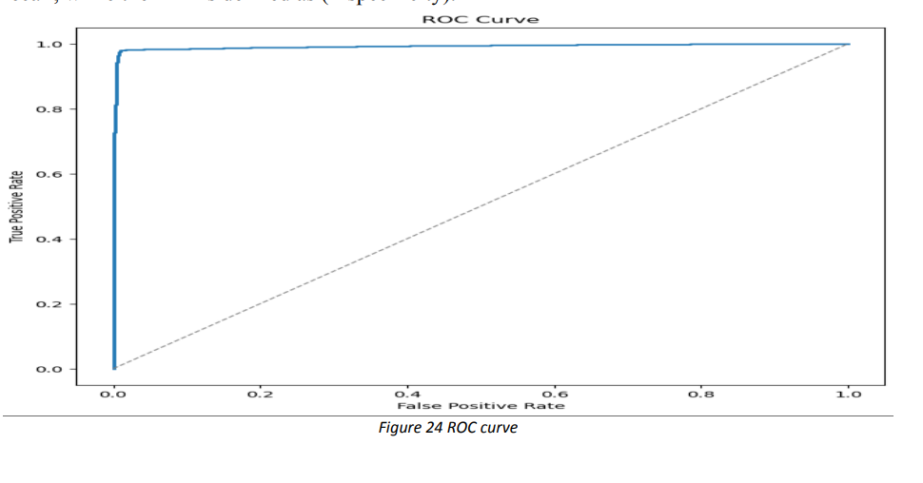
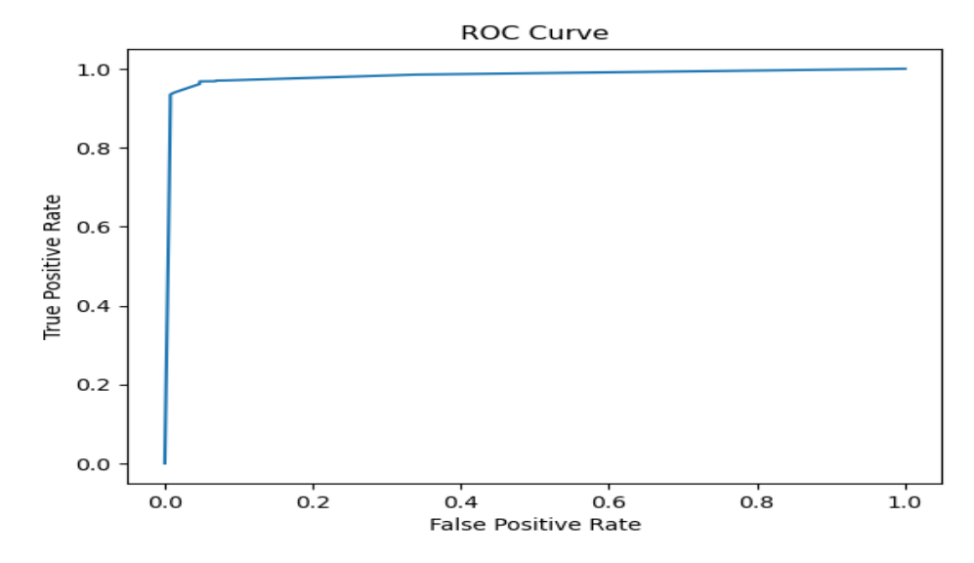
CatBoost classifier's ROC curve performs excellently in distinguishing crashes involving 2 or more vehicles.
AUC score of 0.9948 confirms the classifier’s strong discrimination ability between positive and negative instances.
XGBoost model shows excellent performance in distinguishing between positive and negative instances, as seen from the smooth upward slope of the ROC curve.
AUC score of 0.9820 indicates strong model performance, with higher values suggesting better classification accuracy.

Slide 9
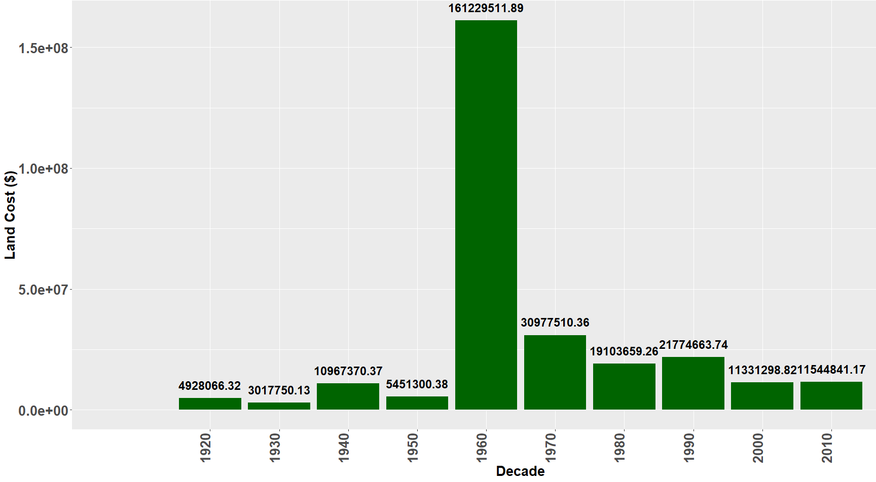
Boston Housing Market
Issue:
Boston's housing market is highly competitive and expensive, driven by high demand and limited supply. Influences include the city's many universities and colleges, attracting numerous students and faculty members
Impact:
External Social Impacts such as the personalization movement and 2008 housing recession impacted land value, total cost within the municipal cities throughout the year.
While variables may impact AVG Total Cost, the strongest relationship comes from Gross Tax and ATC as expected
Response:
Explore and analyzing the data to gain insights into the factor(s) that influence property values in Boston
Conclusion:
Although the market has faced difficulties such a lack of supply and rising housing prices, it continues to be one of the most sought-after and active real estate markets in the United States.
A visualization using bars to depict the building expenses across several decades
1960s grasped the highest land cost of $161M for the city because of the booming "Personalization Movement"

